Slide 1
Crypto Social Network
Owner: Vladyslav Isariev
Lecturer: Iryna Hurklis
University: SUITT

Slide 2
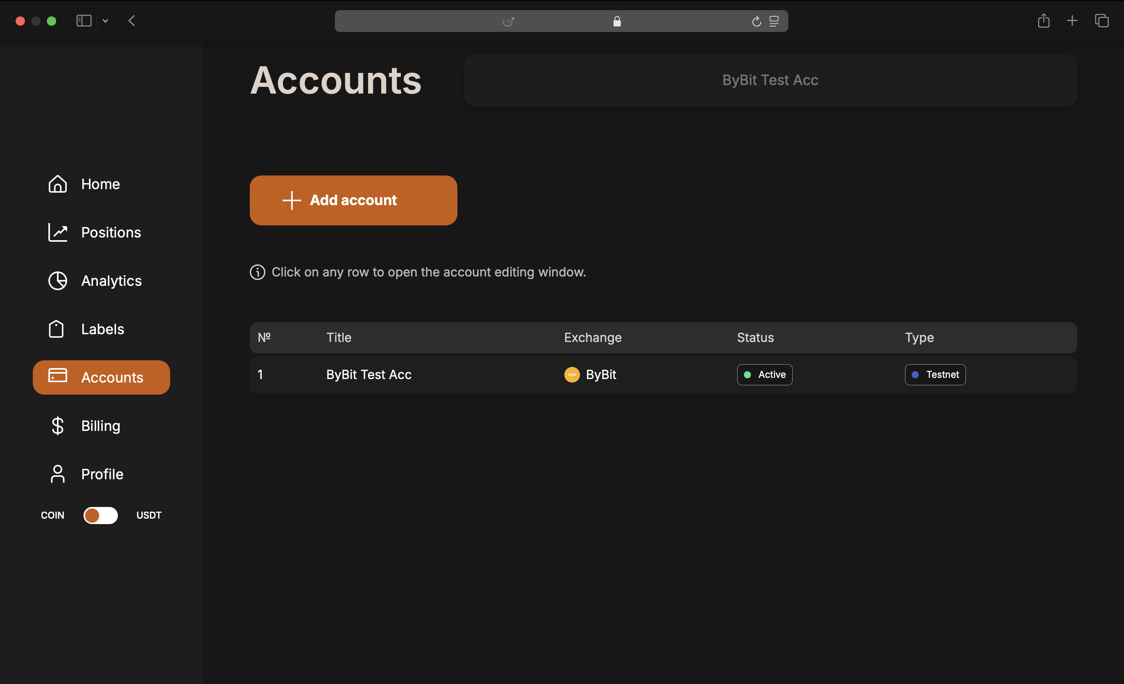
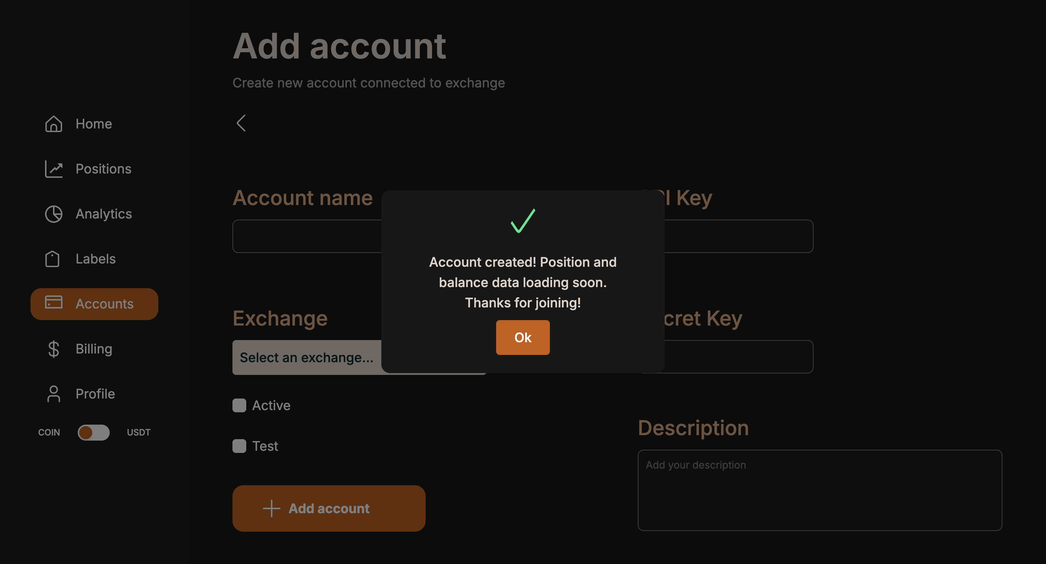
Accounts Tab
Connect multiple accounts from Binance, ByBit, Bitget, and MEXC.
Establish real-time updates through WebSocket connections.
Use Amazon SQS for task distribution across microservices.
Ensure security with AES encryption for storing API keys.

Slide 3
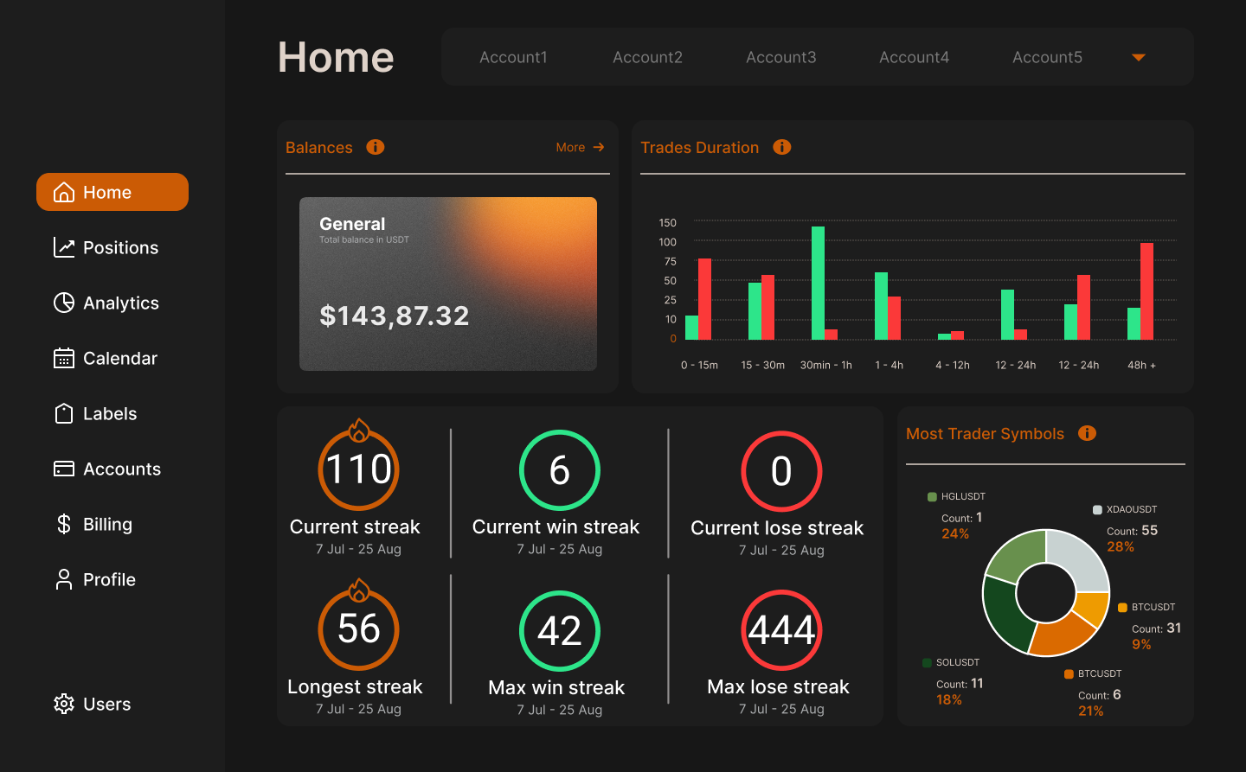
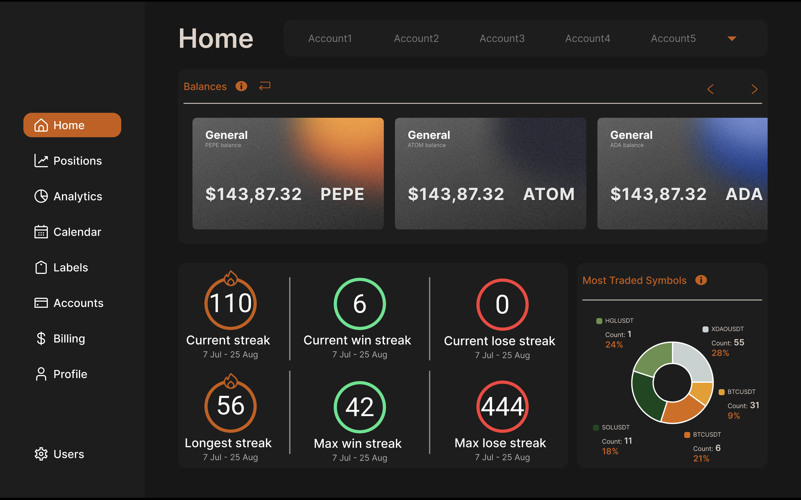
Home Tab
Unique balances feature with real-time sync from multiple exchanges.
Streaks tracker: current, winning, and losing streaks calculated automatically.
Updates through WebSocket connections for real-time data.
Database synchronization ensures always up-to-date information.

Slide 4
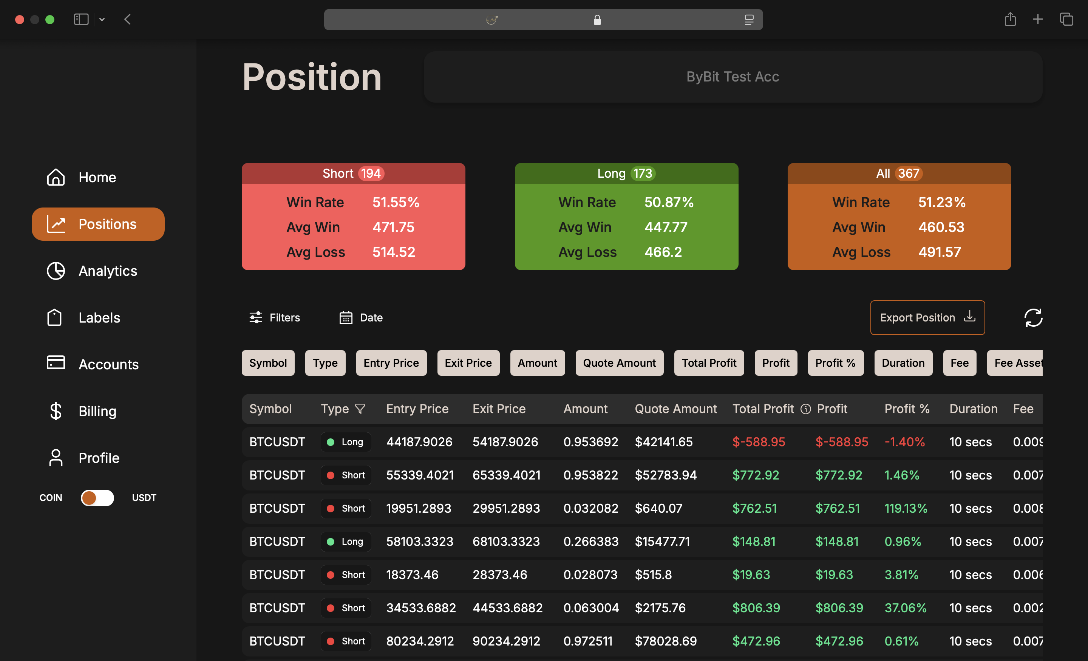
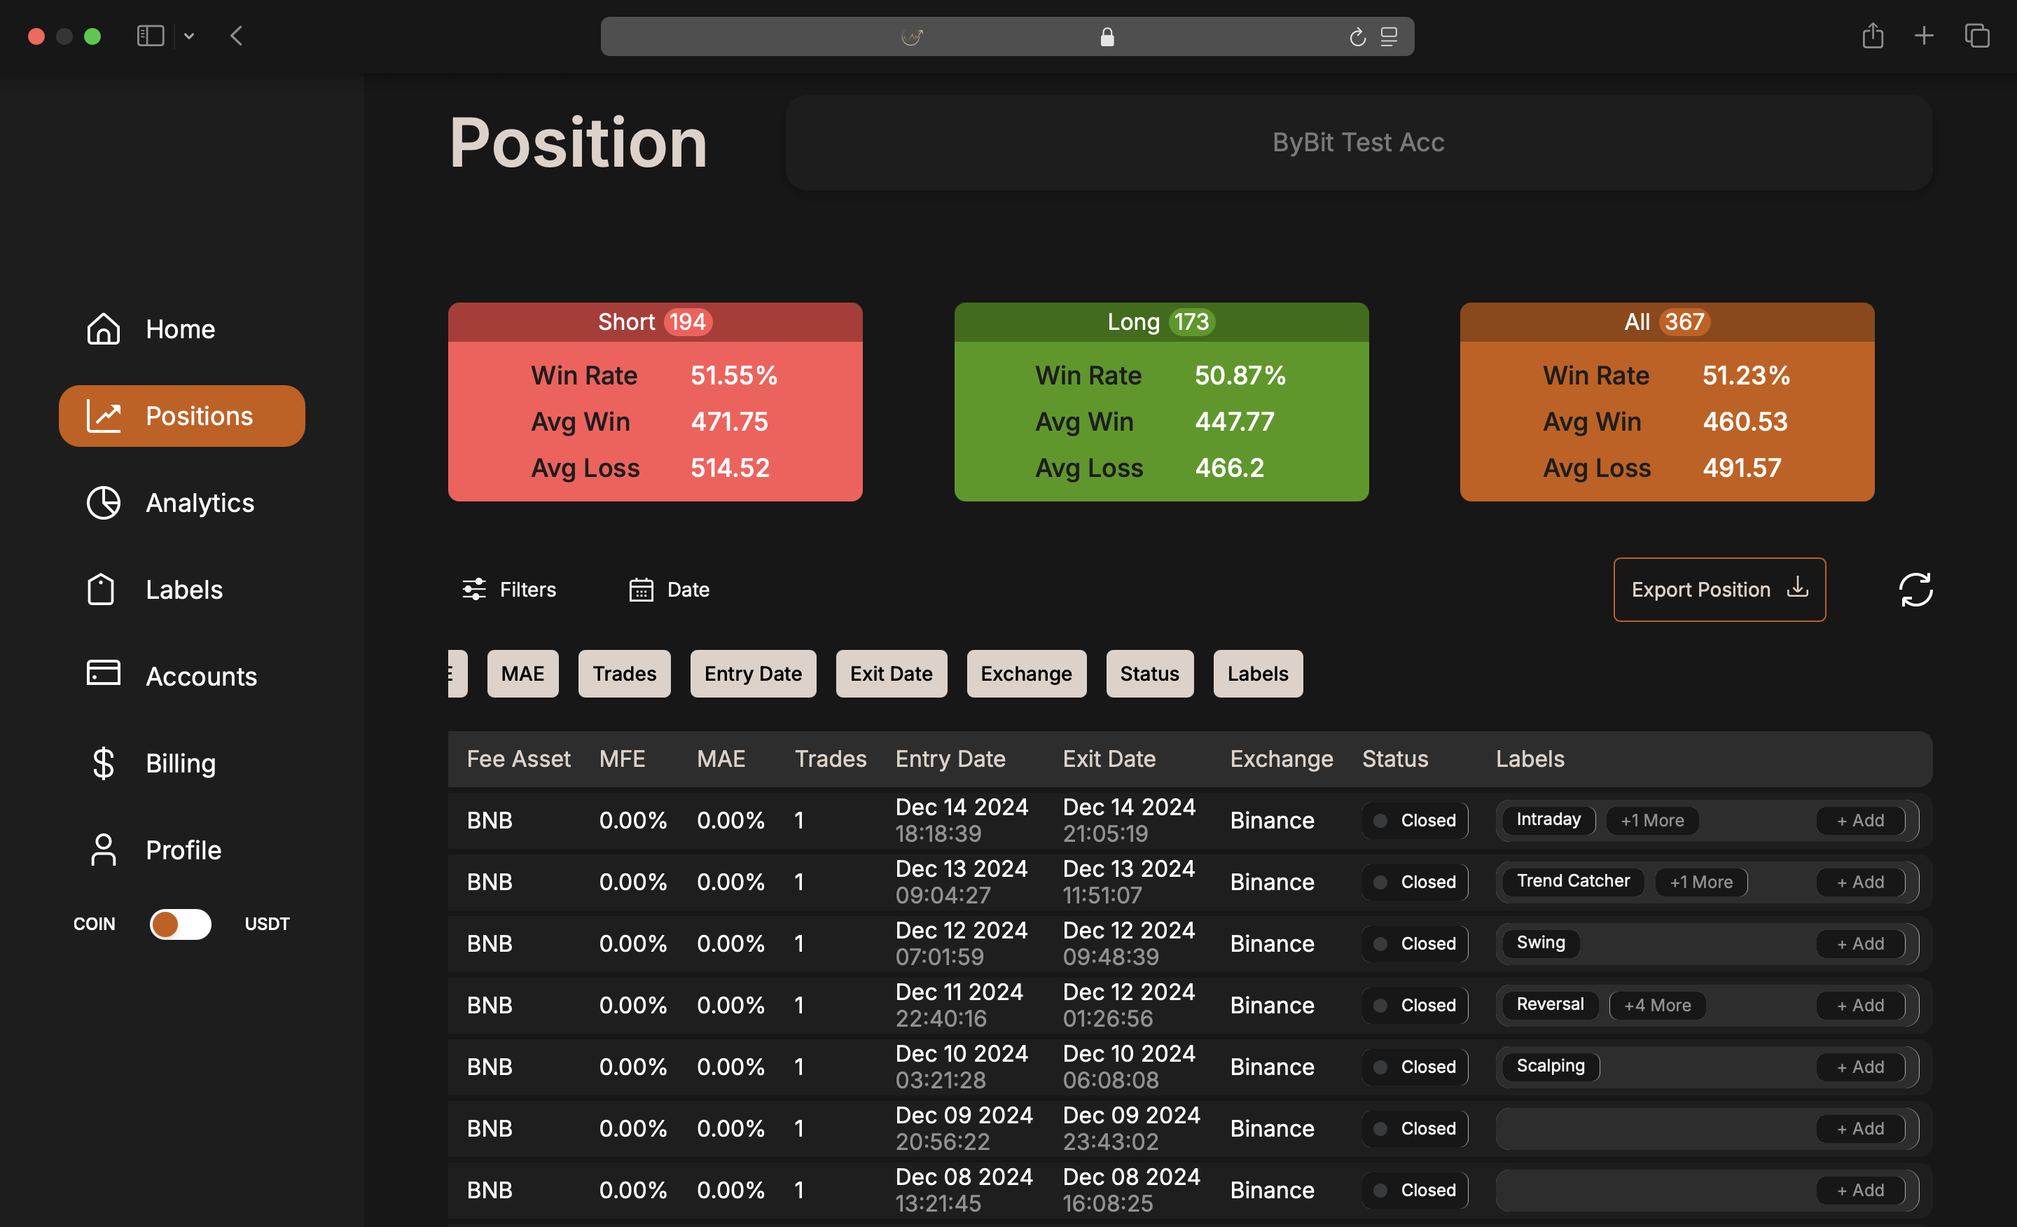
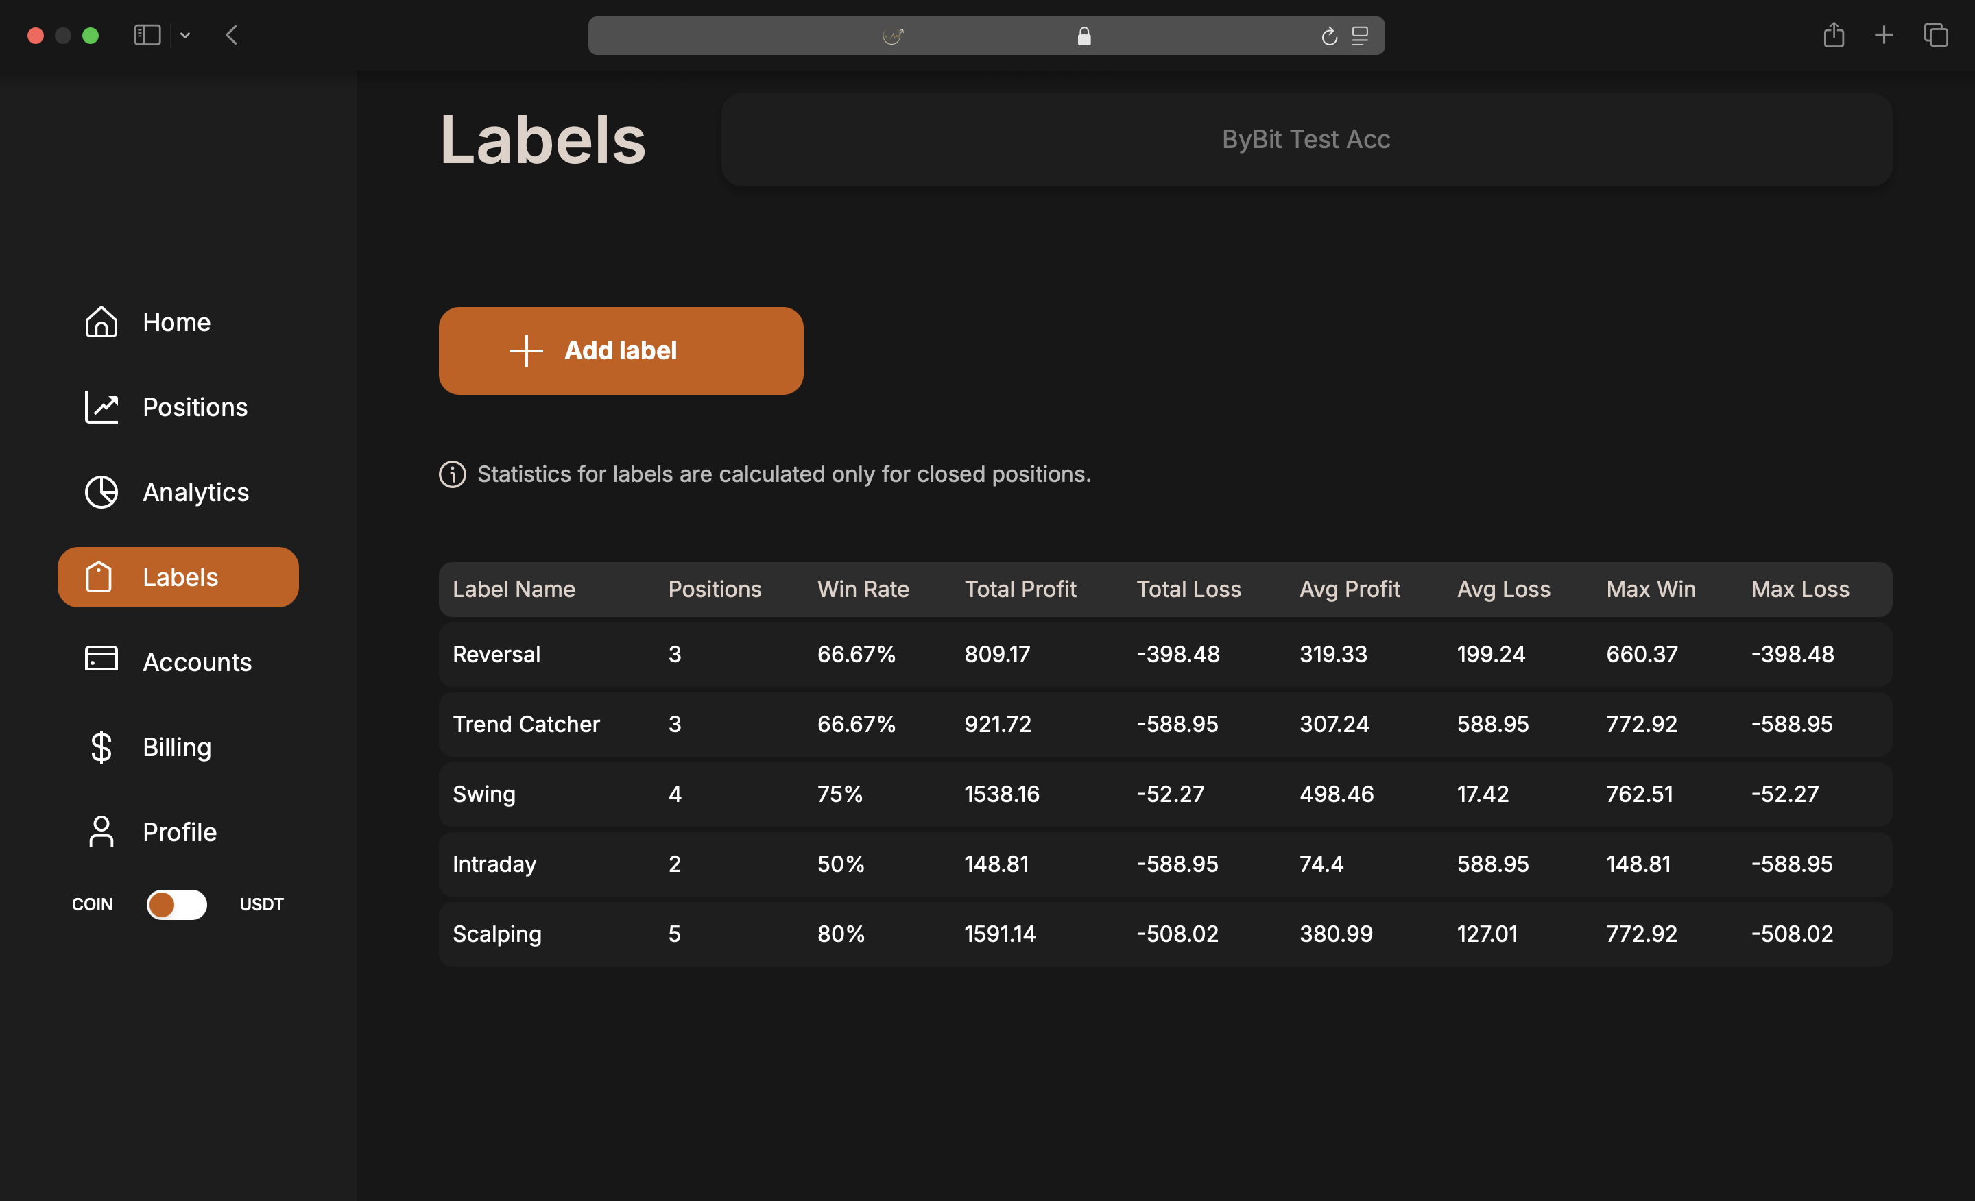
Positions & Labels Tab
Assign labels to organize and analyze trades (e.g., scalping, swing).
Automatic label recalculation upon position closure via WebSocket events.
Quartz Scheduler prevents duplicate task execution.
Flexible and personalized analysis for better strategy insights.

Slide 5
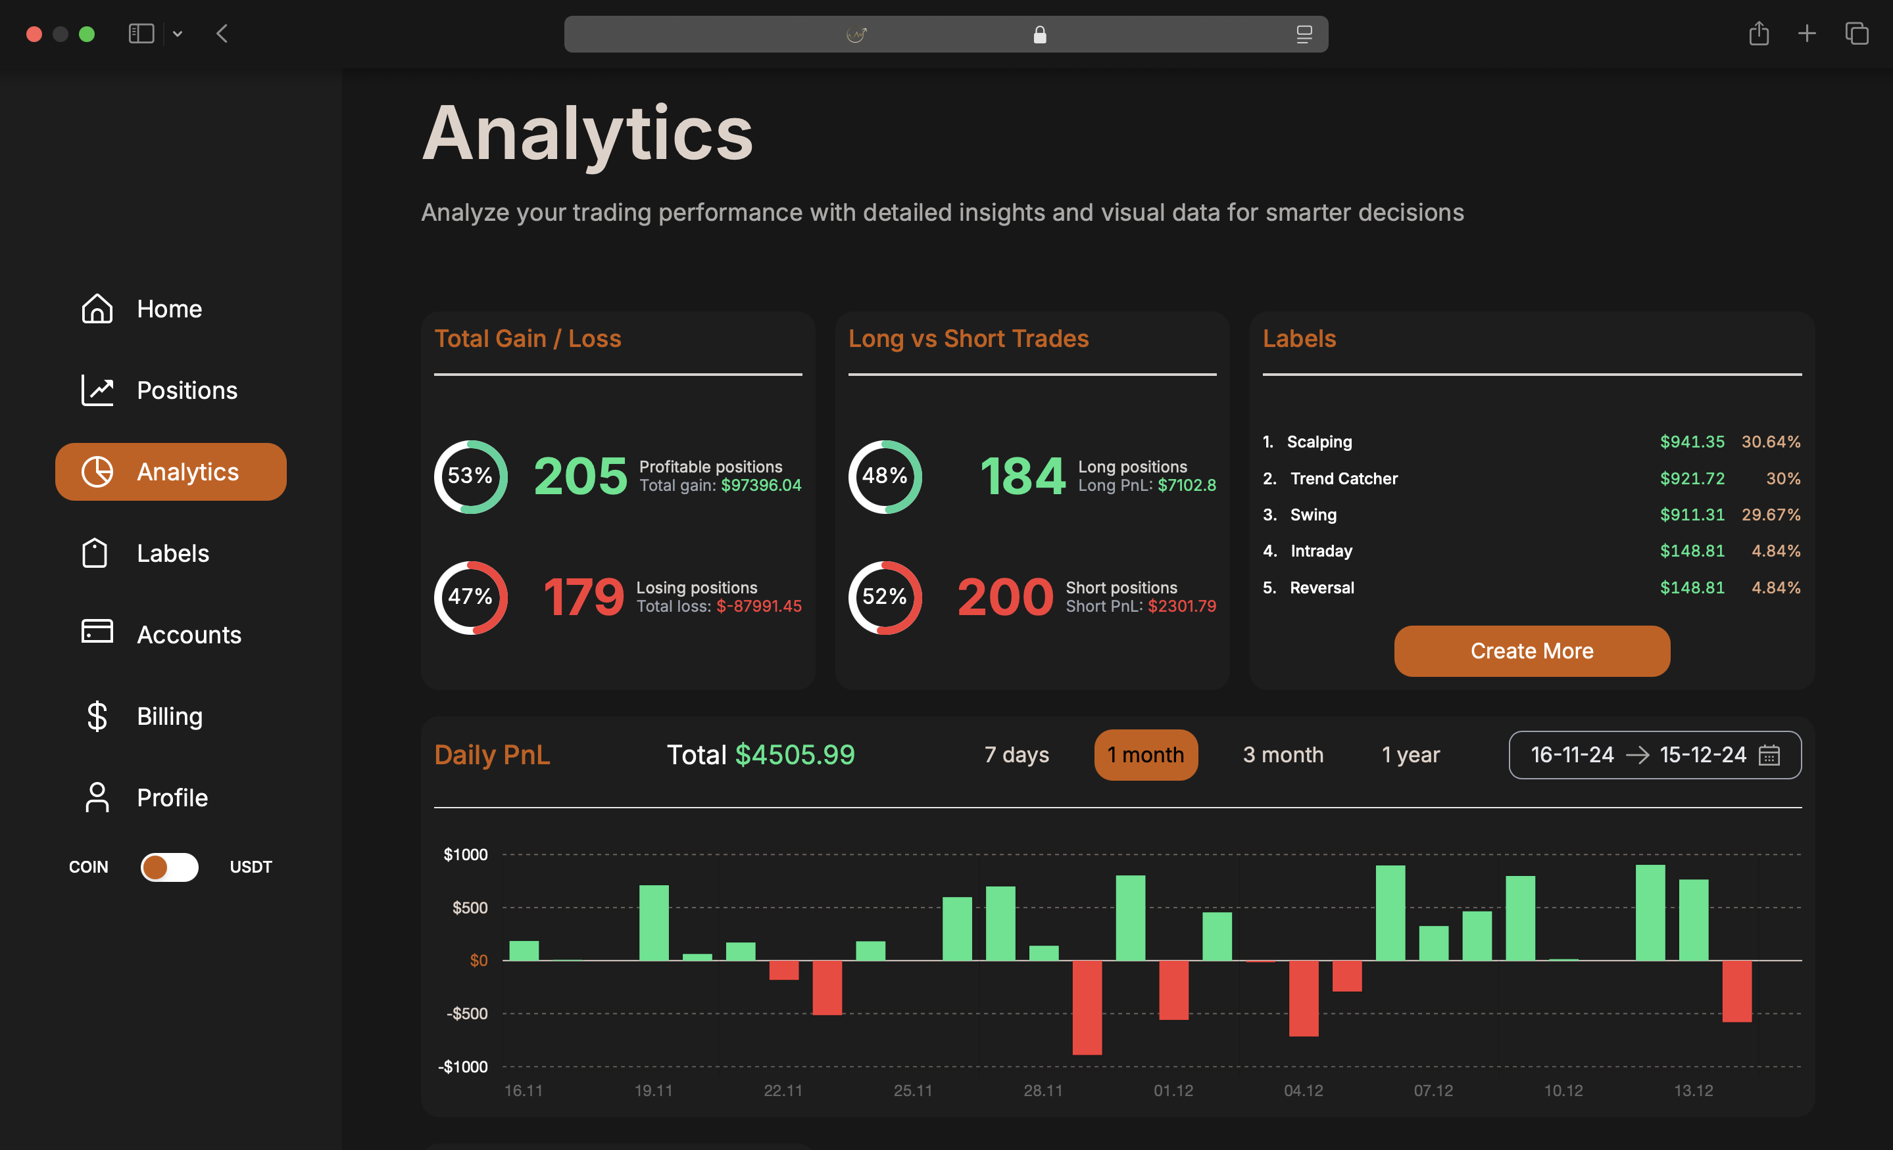
Analytics Tab
Comprehensive performance insights: total gain/loss, long vs. short trades.
Analyze performance by labels for deeper strategy evaluation.
Process streaming data with Apache Kafka.
Helps users track their overall trading efficiency.

Slide 6
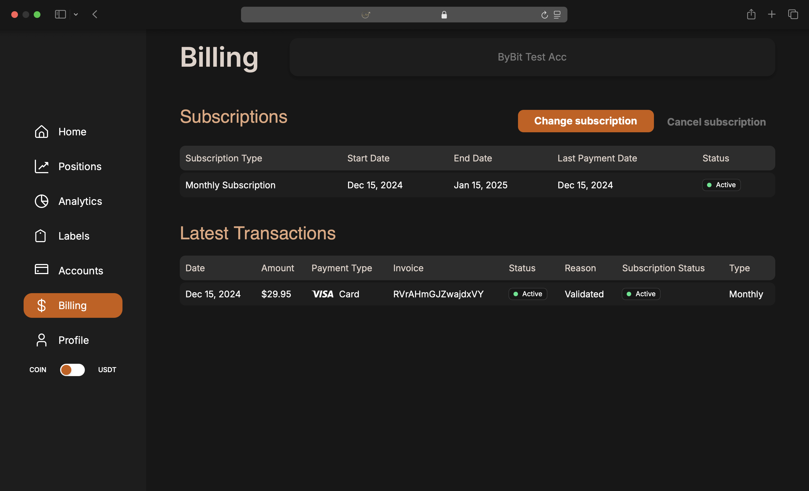
Billing Tab
LiqPay integration for subscription payments; Stripe planned for EU expansion.
Each financial event creates a unique transaction and invoice.
Cancellations generate zero-amount records for full transaction history.
Transparent, user-friendly financial tracking system.

Slide 7
THANKS!

